Slide 1
Well-being Balance Sheet – Qualitative Approach (Using the PowerPoint template in this deck)
As you go through each area, take notes of your credits (resources) and debits (challenges). Consider all areas of your life.
Identify how your resources and challenges impact you and how you feel as a result. Try to get specific about what might be the cause and outcome, not just the symptoms.
In the ‘balance’ column, insert whether you consider this item to be in ‘credit’, ‘debit’ or in ‘balance’.
You can use the Word document, ‘Well-being Balance Sheet – Quantitative’, to quantify your well-being.
In the ‘Well-being slides’ pack there are slides with some areas to consider as a guide.

Slide 2
Well-Being Qualitative Exercise Template

Slide 3
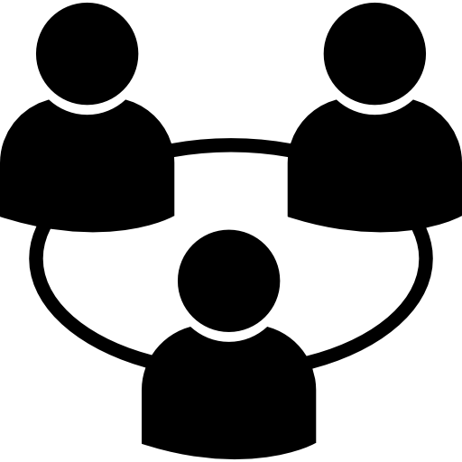
1. Relationships and community
You have authentic relationships
Description | Credits | Debits | Balance
You feel you belong and are close and connected to others individually and in a community
You trust others and can talk openly to them, solving problems and making decisions collaboratively
You are respected and loved by people who are important to you
You invest your time and attention to those you are close to
Your relationships are wholehearted and mutually nourishing
Relationships and community total
GLWSwellbeing.com

Slide 4
2. Sense of Purpose and Direction
You lead a good and full life
Description | Credits | Debits | Balance
You make time to reflect on your life and work and whether you are making the contribution you want to, to the things you consider important
You make changes and refocus your efforts and energies towards the goals you value
You experience spiritual growth
You have a sense of perspective on your life’s challenges and blessings and feel grateful for what you have
You enjoy life and feel fulfilled.
Sense of purpose and direction total
GLWSwellbeing.com

Slide 5
3. Resilience
You have inner strength and emotional evenness in dealing with adversity and are grounded internally
Description | Credits | Debits | Balance
You acknowledge, understand and respond constructively to your emotions in times of adversity, maintaining a sense of calmness and composure even when facing challenges
You ’bounce back’ quickly after stressful events
You are in touch with your emotional state and can regulate your response in emotionally charged situations
You rarely experience periods of anxiety, depression, self-doubt or guilt
You have a sense of peace and contentment
You balance your emotional needs with those of other people in your life
Resilience total
GLWSwellbeing.com

Slide 6
4. Health
You engage in constructive physical, nutritional, mindful and sleep habits to impact your vitality and energy
Description | Credits | Debits | Balance
You manage your energy by pacing yourself and taking time to rest and recover
You are eating the right foods for your body (quantity and quality) and maintaining a healthy body weight
Your drinking habits include enough of the good stuff (water), and less of the bad stuff (caffeine and alcohol)
You have an exercise regime that keeps you fit and moving about regularly
You are aware of your body’s needs and take action to address these when you need to
You use mindfulness and meditation or other techniques to reduce stress and rebalance
You give sleep the attention it deserves
Health total
GLWSwellbeing.com

Slide 7
5. Balance and Boundaries
You’re successful in balancing demands and making choices
Description | Credits | Debits | Balance
Your working hours do not impinge on the other things in your life that are important to who you are and want to be
You are able to give your attention to people, activities and experiences outside of work, without feeling distracted by work demands
You are able to manage competing priorities and have enough time for yourself
You have the right amount of work, most of the time, to feel stimulated and busy, without being overloaded or bored
You feel ‘in control’ of your workload and work calendar
You are comfortable saying ‘no’ and setting personal boundaries in line with your values, aspirations and personal priorities
Balance and boundaries total
GLWSwellbeing.com

Slide 8
6. Interests and Focus
You find stimulation, stimulation, intellectual engagement and enjoyment in what you do at work or in service at home and at play
Description | Credits | Debits | Balance
You feel intellectually stimulated and engaged in your work or where you contribute your time in service
You regularly engage in hobbies and activities that you enjoy and that bring you a sense of satisfaction
You often achieve a deep level of concentration on tasks that you enjoy
You can use your creativity and are able to innovate
You have opportunities for you to learn and expand your mind
You feel satisfied that you are able to use your strengths to the best of your ability
Interests and focus total
GLWSwellbeing.com

