Slide 1
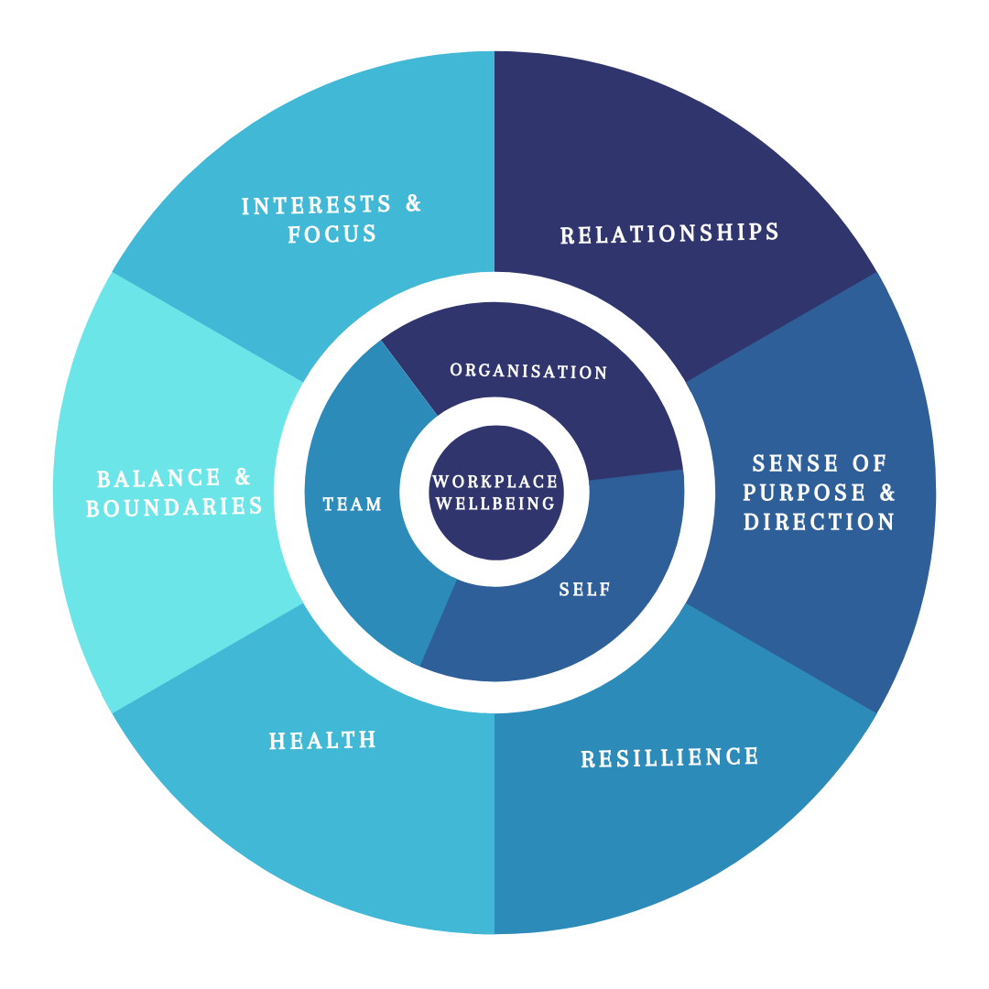
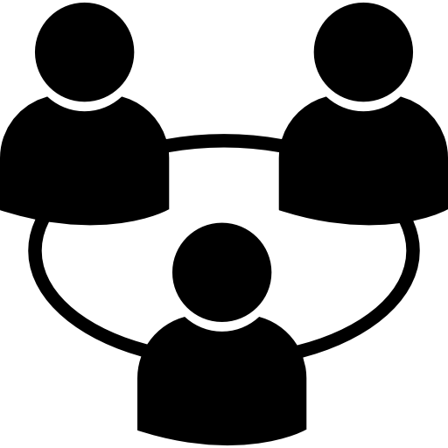
Six Key Themes of Wellbeing
Based on the work by Eek & Sense
Resources
Challenges
In all roles
& all identities
GLWSwellbeing.com

Slide 2
Well-being Balance Sheet – Qualitative Approach (Use the PowerPoint template)
As you go through each area, take notes of your credits (resources) and debits (challenges). Consider all areas of your life.
Identify how your resources and challenges impact you and how you feel as a result. Try to get specific about what might be the cause and outcome, not just the symptoms.
In the ‘balance’ column, insert whether you consider this item to be in ‘credit’, ‘debit’ or in ‘balance’.
You can use the Word document, ‘Well-being Balance Sheet Quantitative’, to quantify your well-being.
The templates to complete this exercise are in the document: ‘Well-being Balance Sheet Qualitative’.

Slide 3
Well-being Balance Sheet – Quantitative Approach (use the Word Template)
Do this exercise to assess your well-being quantitatively in each area and overall.
Using the notes that you have made in the Qualitative Well-being exercise of your credits (resources) and debits (challenges); score each item with a credit of 0 to +5 and a debit of 0 to -5 and calculate your balance.
At the bottom of each area, do a qualitative assessment of your overall well-being, taking into account the weighting that you put on the various items.
The template to complete this exercise is in the document: ‘Well-being Balance Sheet Quantitative’.
For example
On an item, you may have some significant credits that you can list and even score a +5; however, there is a challenge that you’re dealing with that is really depleting, which you score at a -4. This means your well-being balance is only +1 on this item.
When you put this into context over the whole area, you may put a greater or lesser weighting or emphasis on this item to give an overall score.

Slide 4
Example areas to consider for the qualitative exercise

Slide 5
1. Relationships and community
Areas to consider
You have authentic relationships
Description | Credits | Debits | Balance
You feel you belong and are close and connected to others individually and in a community | Sense of community and belonging | Isolated, disconnected, lonely
You trust others and can talk openly to them, solving problems and making decisions collaboratively | Trust and safety enable openness and vulnerability | Suspicious and concerned for safety leading to protection, defensiveness
You are respected and loved by people who are important to you | Respected and loved | Taken for granted
You invest your time and attention to those you are close to | Invested in loving contribution | Underinvested leading to shame/guilt
Your relationships are wholehearted and mutually nourishing | Mutually nourishing | Depleting
Relationships and community total
GLWSwellbeing.com

Slide 6
2. Sense of Purpose and Direction
Areas to consider
You lead a good and full life
Description | Credits | Debits | Balance
You make time to reflect on your life and work and whether you are making the contribution you want to, to the things you consider important | Prioritising strategic choices, reflecting before acting | Reflex reaction, consumed with urgent tasks
You make changes and refocus your efforts and energies towards the goals you value | Acting strategically and purposefully | Never get to what you truly value or aspire to
You experience spiritual growth | Growth from abundance mindset and faith in good | Stuck in scarcity and sceptical that there is any good
You have a sense of perspective on your life’s challenges and blessings and feel grateful for what you have | Learn and contribute when faced with a challenge; surf the wave. Gratitude first. | Gratitude is hard when I’m hard done by. Overwhelmed, feeling of resentment and despair
You enjoy life and feel fulfilled. | When I’m happy good things happen | I'll be happy when good things happen
Sense of purpose and direction total
GLWSwellbeing.com

Slide 7
3. Resilience
Areas to consider
You have inner strength and emotional evenness in dealing with adversity and are grounded internally
Description | Credits | Debits | Balance
You acknowledge, understand and respond constructively to your emotions in times of adversity, maintaining a sense of calmness and composure even when facing challenges | Pause and put distance between stimulus and response | React emotionally
You ’bounce back’ quickly after stressful events | Able to move on | Remain in the event, unable to move on
You are in touch with your emotional state and can regulate your response in emotionally charged situations | Self-aware and centred, calm | Unpredictable and emotionally charged
You rarely experience periods of anxiety, depression, self-doubt or guilt | Self-assured | Anxious, depressed, self-doubting, feeling guilt or shame
You have a sense of peace and contentment | Peaceful | Disturbed
You balance your emotional needs with those of other people in your life | Your needs balanced with others’ wants Boundaries in place | Others wants preside over your needs Lack of boundaries
Resilience total
GLWSwellbeing.com

Slide 8
4. Health
Areas to consider
You engage in constructive physical, nutritional, mindful and sleep habits to impact your vitality and energy
Description | Credits | Debits | Balance
You manage your energy by pacing yourself and taking time to rest and recover | Energy and vitality high | Energy and vitality low or ’peaky’
You are eating the right foods for your body (quantity and quality) and maintaining a healthy body weight | Nourished and healthy body | Badly nourished and body weight/shape not ideal
Your drinking habits include enough of the good stuff (water), and less of the bad stuff (caffeine and alcohol) | Emphasis on good drinking habits | Bad drinking habits take precedence
You have an exercise regime that keeps you fit and moving about regularly | Exercise regime aligned with body needs and targets | Lack of exercise regime/ discipline that will achieve desired health
You are aware of your body’s needs and take action to address these when you need to | Actively address unbalance | Let it go
You use mindfulness and meditation or other techniques to reduce stress and rebalance | Rebalancing techniques to reduce/manage stress | Don't manage stress well
You give sleep the attention it deserves | ‘Try my best to get a good night’s sleep’ | Sleep regime not applied
Health total
GLWSwellbeing.com

Slide 9
5. Balance and Boundaries
Areas to consider
You’re successful in balancing demands and making choices
Description | Credits | Debits | Balance
Your working hours do not impinge on the other things in your life that are important to who you are and want to be | Work hours are regulated in line with the balance required | Work too hard, too long impeding rest of life
You are able to give your attention to people, activities and experiences outside of work, without feeling distracted by work demands | Boundaries in place to manage work distractions/ commitments | Work distractions undermine personal commitments
You are able to manage competing priorities and have enough time for yourself | Prioritise self regularly | Prioritise work over self too often
You have the right amount of work, most of the time, to feel stimulated and busy, without being overloaded or bored | Work is stimulating and fulfilling | Work overloads or work lacks stimulation and interest
You feel ‘in control’ of your workload and work calendar | In control | Out of control
You are comfortable saying ‘no’ and setting personal boundaries in line with your values, aspirations and personal priorities | Boundaries in place | No boundaries set
Balance and boundaries total
GLWSwellbeing.com

Slide 10
6. Interests and Focus
Areas to consider
You find stimulation, stimulation, intellectual engagement and enjoyment in what you do at work or in service at home and at play
Description | Credits | Debits | Balance
You feel intellectually stimulated and engaged in your work or where you contribute your time in service | Contributions stimulate and fulfil me | Contribution has no value and not valued
You regularly engage in hobbies and activities that you enjoy and that bring you a sense of satisfaction | Satisfaction from hobbies | Don’t have time or interest in hobbies and activities
You often achieve a deep level of concentration on tasks that you enjoy | I’m engaged in what I do | I’m not engaged
You can use your creativity and are able to innovate | Creativity brings fulfilment | Life lacks creativity
You have opportunities for you to learn and expand your mind | I learn and grow | Lacking learning and growth
You feel satisfied that you are able to use your strengths to the best of your ability | I fulfil my potential | My potential is not fulfilled
Interests and focus total
GLWSwellbeing.com

